Slide 1


Slide 2
Compilers: The Link Between
High Level and Low Level Programming
Instructor: Carson Gross
carson.gross@montana.edu

Slide 3
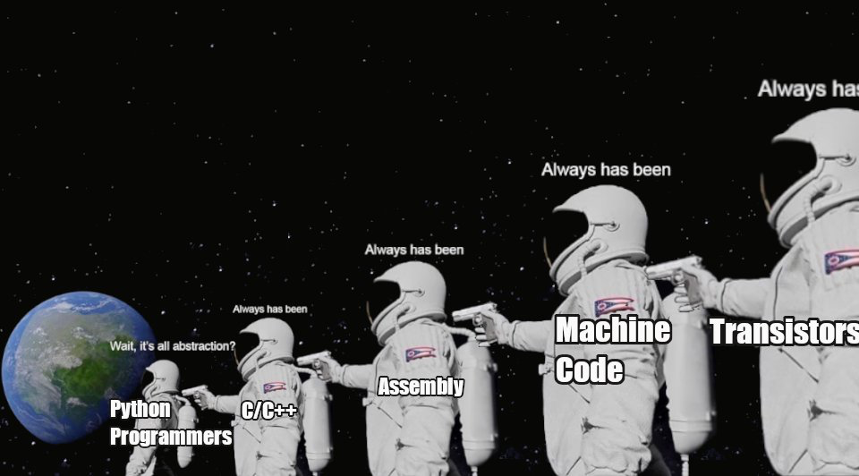

Slide 4
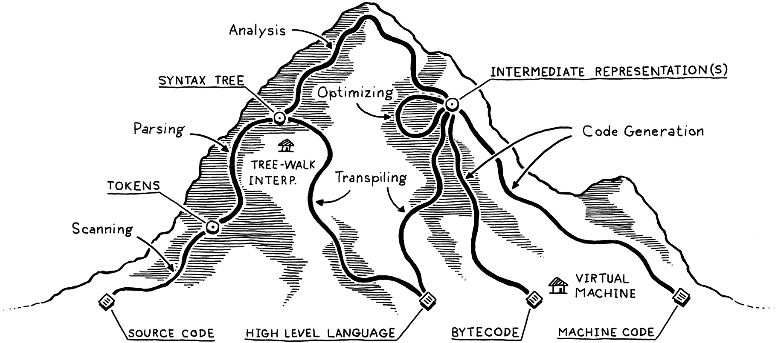
Getting From C to Assembly
Thus far we have been looking at low level computing
How to make logical gates out of sand
How to build complex logic out of simple logical gates (e.g. an adder)
How to drive complex logic with instructions (machine code)
How to program machines with low level assembly
Notes:
Can be found online… but I can’t link to it

Slide 5
Getting From C to Assembly
Most programming today, thankfully, is not done at this level
Rather, it is done in a high-level language and compiled to assembly (or bytecode, etc.)
Notes:
Can be found online… but I can’t link to it

Slide 6
Getting From C to Assembly
The tool used to do this is known as a compiler
I teach the compilers capstone course, CSCI 468, where we compile a high level language, CatScript, to JVM byte-code
Notes:
Can be found online… but I can’t link to it

Slide 7
Getting From C to Assembly
Today we are going to look at the components of a compiler and how exactly C is compiled down to assembly
Yes, C is a high-level programming language!
May not seem like it, but it is!
Notes:
Can be found online… but I can’t link to it

Slide 8
The Map

Slide 9
Components Of A Compiler
The major components of a compiler that targets assembly are:
Scanning/Lexing
Parsing
Analysis/Intermediate Representations
Code Generation
Notes:
Can be found online… but I can’t link to it

Slide 10

Scanning
Scanning also called lexing, tokenizing or lexical analysis is the process of breaking text into individual tokens
This typically involves discarding meaningless white space, comments, etc.
// compute an average
var average =
(min + max)/2;
Notes:
Can be found online… but I can’t link to it

Slide 11
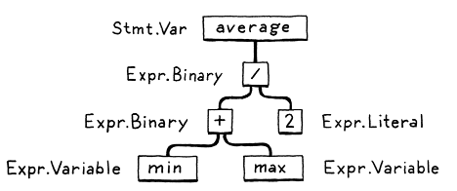
Parsing
The next step is parsing
This is where the stream of tokens are turned into into a Parse Tree
Also sometimes called an Abstract Syntax Tree (AST)
The parser can tell us if there is a Syntax Error
Notes:
Can be found online… but I can’t link to it

Slide 12
Analysis
With a parse tree it is then possible to do to analysis of the code
“Does another variable have this variables name?”
“Is the right hand side compatible with the left and side?”
Notes:
Can be found online… but I can’t link to it

Slide 13
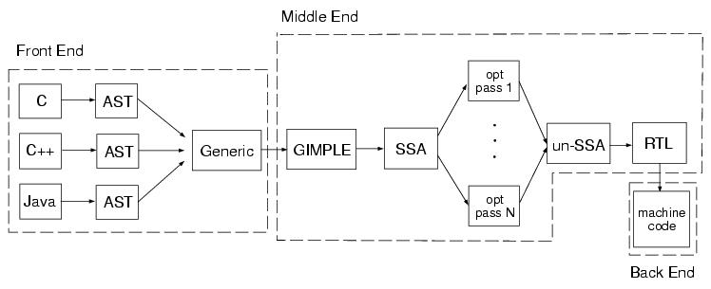
Static Analysis
Lexing through Static Analysis is considered the “front end”
At right is a diagram of the gcc internals
The “ends” of a compiler
Front end
Middle end
Back end
Notes:
Can be found online… but I can’t link to it

Slide 14
Intermediate Representations
In many compilers the initial AST is transformed into a new tree structure that better captures or represents the final output
These new structures are known as an Intermediate Representations
Notes:
Can be found online… but I can’t link to it

Slide 15
Optimization
Many compilers have a heavy focus on optimization
Producing the fastest possible code that is semantically compatible with the users program
Heavily optimized code can often run 3-10x faster than unoptimized code
Notes:
Can be found online… but I can’t link to it

Slide 16
Code Generation
The final step is when the compiler generates code
Sometimes called code gen
You may think of code gen as, for example, generating Java code
In this case, we are talking about generating assembly code
Notes:
Can be found online… but I can’t link to it

Slide 17
Code Generation
With the Little Man Computer and Little Man Stack machine, you are seeing how assembly can be used to generate machine code
Also a kind of “code gen”
With a compiler, we are generating assembly
Allows us to impose more abstractions on top of assembly!
Notes:
Can be found online… but I can’t link to it

Slide 18

Code Generation
Let’s take a look at how compilation links high level programming to low level assembly by looking at the Godbolt compiler explorer: https://godbolt.org/
Notes:
Can be found online… but I can’t link to it

Slide 19
Code Generation
This compiler explorer lets us look at various source programs and how gcc, the GNU compiler, would turn that code into assembly for various target architectures
In our case, we will look at MIPS
Not exactly like the MIPS we have been looking at, but close!
Notes:
Can be found online… but I can’t link to it

Slide 20
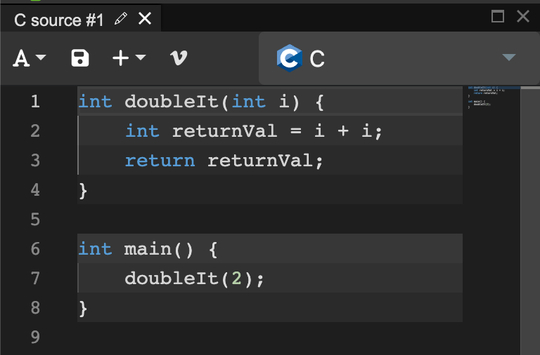
Doubling An Integer
Consider the simple C program at right, which includes a main() method and a simple function, doubleIt() that doubles the value of an integer
Notes:
Can be found online… but I can’t link to it

Slide 21
Doubling An Integer
Gcc takes this code and puts it through the aforementioned stages of compilation:
It scans it into tokens
It parses it
It validates/analyses the code
Finally, it generates MIPS assembly
Notes:
Can be found online… but I can’t link to it

Slide 22
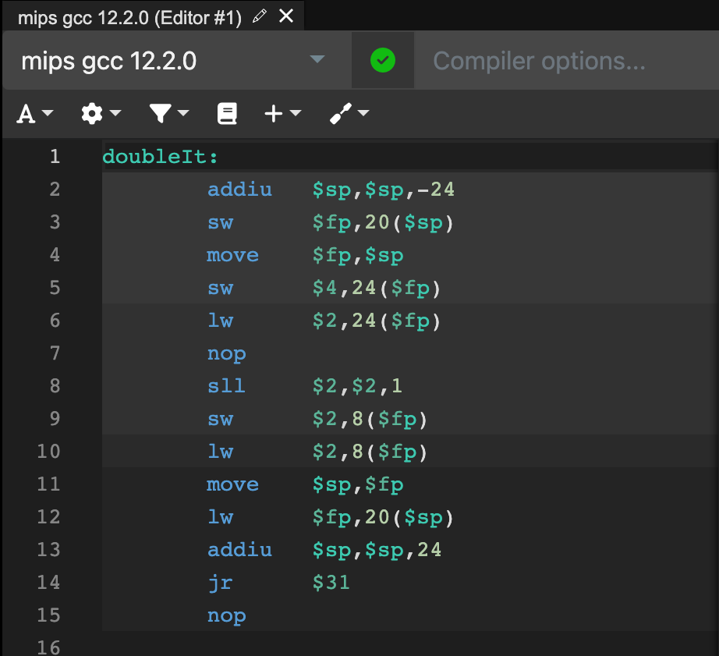
Doubling An Integer
Here is the generated code for doubleIt()
Let’s go through it line by line
The first thing the function does is bump the stack pointer down by 24 bytes
As with most systems, the stack grows down in memory
This provides the function “working space” on the stack to store temporary values
Notes:
Can be found online… but I can’t link to it

Slide 23
Doubling An Integer
The next thing the code does is save fp (frame pointer) value out to the stack at an offset of 20
It then moves the current stack pointer to the frame pointer register
All local variables are stored relative to the frame pointer
Notes:
Can be found online… but I can’t link to it

Slide 24
Doubling An Integer
The next thing it does is something kind of funny: it moves $4, which is $a0, the argument register, out to the stack
It then moves the value right back off the stack into $v0
Notes:
Can be found online… but I can’t link to it

Slide 25
Doubling An Integer
Next comes a NOP instruction, inserted most likely to byte align the instructions
Machines often execute instructions most quickly when they are aligned on some multiple of 2
Notes:
Can be found online… but I can’t link to it

Slide 26
Doubling An Integer
Now comes a subtle one: the compiler emitted a shift left instruction, shifting the $v0 register once to the right
Why?
Hint: this corresponds with the expression “i + i”
Notes:
Can be found online… but I can’t link to it

Slide 27
Doubling An Integer
If you think about it, “i + i” is the equivalent of “2 * i”
And if you remember from our early discussion on shift operators, shifting once to the left is the equivalent of multiplying by 2
And remember: shifting is very fast when compared with an adder!
Notes:
Can be found online… but I can’t link to it

Slide 28
Doubling An Integer
This is an example of a compiler optimization finding its way into the low level generated code
On the other hand, what about all that useless data shuffling? And there is more to come!
Notes:
Can be found online… but I can’t link to it

Slide 29
Doubling An Integer
Once the value in $v0 is doubled, it is once again saved out to the stack, now in an offset of 8 from the frame pointer
But then tt is then loaded back into $v0!
Very inefficient!
Notes:
Can be found online… but I can’t link to it

Slide 30
Doubling An Integer
We are now ready to return from the doubleIt() function
We need to move the current frame pointer back to the stack pointer
Then load the old frame pointer value from the stack
Then bump the stack pointer back up to its initial value
Notes:
Can be found online… but I can’t link to it

Slide 31
Doubling An Integer
Finally, we have a jump register instruction to jump back to where the doubleIt() function was called from
And a last little nop to keep everything properly aligned
Notes:
Can be found online… but I can’t link to it

Slide 32
Doubling An Integer
Things to notice
We once again see the symmetry around function calls with respect to the stack
Allocate some stack space at the start, save stuff out to it, deallocate the stack space at the end
We can see a clever compiler optimization around doubling a value
Notes:
Can be found online… but I can’t link to it

Slide 33
Doubling An Integer
But what about that data shuffling?
On the other hand, there is an awful lot of pointless shuffling data from registers to the stack!
This could probably be reduced by increasing the optimization settings for our compiler
May also be detected by the MIPS hardware and optimized
Notes:
Can be found online… but I can’t link to it

Slide 34
Doubling An Integer
This sort of thing is why early assembly programmers weren’t always enamored with compilers: why would you put up with garbage assembly like this when you could just hand code it and make it right?
Notes:
Can be found online… but I can’t link to it

Slide 35
Main: Calling A Function
Now let’s look at the code generated for that main function
It’s a simple body that just calls the doubleIt() function with the value 2
Notes:
Can be found online… but I can’t link to it

Slide 36
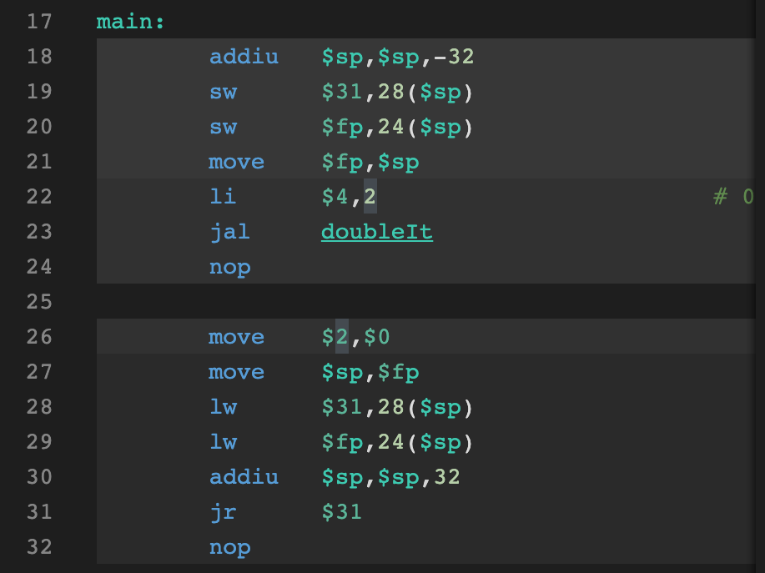
Main: Calling A Function
We’ll skip over the start and end of the function, this is the same rigamarole that we saw in the last function around the stack
Instead focus on the instructions on line 22 and 23
First, load the value 2 into $a0, the argument register
Notes:
Can be found online… but I can’t link to it

Slide 37
Main: Calling A Function
Next, use the magical jump and link instruction to jump to doubleIt and push the next instruction’s address into $ra
This is the crux of the function call abstraction, and this is how C function calls compile down to the related assembly
Notes:
Can be found online… but I can’t link to it

Slide 38
Main: Calling A Function
It may not look like much, but this is how we get from doubleIt(2) down to something that the computer can almost understand
This is one of the pieces of deep magic of this class! Please understand it at least at a high level!
Notes:
Can be found online… but I can’t link to it

Slide 39
Firth: A Compiler for LMSM
The Little Man Stack Machine has it’s own compiler: firth!
A simple “high level” programming language that compiles to LMSM assembly
Which is then converted to LMSM machine code
Let’s take a look…
Notes:
Can be found online… but I can’t link to it

Slide 40
Compilers
Today we looked at how Compilers work, with a focus on the code generation aspect
It is code generation that links high level languages like C to low level assembly
The compiler also has other phases: scanning, parsing, etc.
Take CSCI 468 to learn more about those aspects of a compiler
Remember: there is no such thing as a function, but without them we wouldn’t be able to build the software systems we do!

